Slide 1
Course Code : | BPLCK105B/205B | Semester / Year : | II / I
Course Title : | Introduction to Python Programming | Academic Year : | 2024-25

Slide 2
Module 1
Python Basics: Entering Expressions into the Interactive Shell, The Integer, Floating-Point, and String Data Types, String Concatenation and Replication, Storing Values in Variables, Your First Program, Dissecting Your Program
Flow control: Boolean Values, Comparison Operators, Boolean Operators,Mixing Boolean and Comparison Operators, Elements of Flow Control, Program Execution, Flow Control Statements, Importing Modules,Ending a Program Early with sys.exit()
Functions: def Statements with Parameters, Return Values and return Statements,The None Value, Keyword Arguments and print(), Local and Global Scope, The global Statement, Exception Handling
A Short Program: Guess the Number

Slide 3
Python Basics

Slide 4
Entering Expressions into the Interactive Shell
Enter 2 + 2 at the prompt to have Python do some simple math.
In Python, 2 + 2 is called an expression, which is the most basic kind of programming instruction in the language.
Expressions consist of values (such as 2) and operators (such as +), and they can always evaluate (that is, reduce) down to a single value.
That means you can use expressions anywhere in Python code that you could also use a value.
In the previous example, 2 + 2 is evaluated down to a single value, 4.
A single value with no operators is also considered an expression, though it evaluates only to itself, as shown here:

Slide 5
Entering Expressions into the Interactive Shell
ERRORS ARE OKAY!
Programs will crash if they contain code the computer can’t understand, which will cause Python to show an error message.
An error message won’t break your computer, though, so don’t be afraid to make mistakes.
A crash just means the program stopped running unexpectedly.
If you want to know more about an error, you can search for the exact error message text online for more information. You can also check out the resources at https://nostarch.com/automatestuff2/ to see a list of common Python error messages and their meanings.

Slide 6
Entering Expressions into the Interactive Shell
You can use plenty of other operators in Python expressions, too.
Table 1-1: Math Operators from Highest to Lowest Precedence
Operator | Operation | Example | Evaluates to . . .
** | Exponent | 2 ** 3 | 8
% | Modulus/remainder | 22 % 8 | 6
// | Integer division/floored quotient | 22 // 8 | 2
/ | Division | 22 / 8 | 2.75
* | Multiplication | 3 * 5 | 15
- | Subtraction | 5 - 2 | 3
+ | Addition | 2 + 2 | 4

Slide 7
Entering Expressions into the Interactive Shell
The order of operations (also called precedence) of Python math operators is similar to that of mathematics.
The ** operator is evaluated first; the *, /, //, and % operators are evaluated next, from left to right; and the + and - operators are evaluated last (also from left to right).
You can use parentheses to override the usual precedence if you need to.
Whitespace in between the operators and values doesn’t matter for Python (except for the indentation at the beginning of the line), but a single space is convention.

Slide 8
Entering Expressions into the Interactive Shell
Enter the following expressions into the interactive shell:
>>> 2 + 3 * 6
>>> (2 + 3) * 6
>>> 48565878 * 578453
>>> 2 ** 8
>>> 23 / 7
>>> 23 // 7
>>> 23 % 7
>>> 2 + 2
>>> (5 - 1) * ((7 + 1) / (3 - 1))

Slide 9
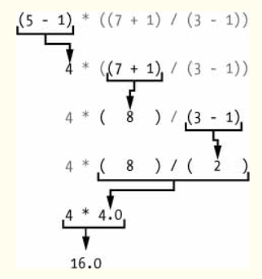
Entering Expressions into the Interactive Shell
In each case, you as the programmer must enter the expression, but Python does the hard part of evaluating it down to a single value. Python will keep evaluating parts of the expression until it becomes a single value, as shown here:

Slide 10
Entering Expressions into the Interactive Shell
These rules for putting operators and values together to form expressions are a fundamental part of Python as a programming language, just like the grammar rules that help us communicate. Here’s an example:
This is a grammatically correct English sentence.
This grammatically is sentence not English correct a.
The second line is difficult to parse because it doesn’t follow the rules of English.

Slide 11
Entering Expressions into the Interactive Shell
Similarly, if you enter a bad Python instruction, Python won’t be able to understand it and will display a SyntaxError error message, as shown here:
>>> 5 +
>>> 42 + 5 + * 2
You can always test to see whether an instruction works by entering it into the interactive shell.
Don’t worry about breaking the computer: the worst that could happen is that Python responds with an error message.
Professional software developers get error messages while writing code all the time.

Slide 12
The Integer, Floating-Point, and String Data Types
Remember that expressions are just values combined with operators, and they always evaluate down to a single value.
A data type is a category for values, and every value belongs to exactly one data type.
The values -2 and 30, for example, are said to be integer values.
The integer (or int) data type indicates values that are whole numbers. Numbers with a decimal point, such as 3.14, are called floating-point numbers (or floats).
Note that even though the value 42 is an integer, the value 42.0 would be a floating-point number.

Slide 13
The Integer, Floating-Point, and String Data Types
Table 1-2: Common Data Types
Data type | Examples
Integers | -2, -1, 0, 1, 2, 3, 4, 5
Floating-point numbers | -1.25, -1.0, -0.5, 0.0, 0.5, 1.0, 1.25
Strings | 'a', 'aa', 'aaa', 'Hello!', '11 cats'

Slide 14
The Integer, Floating-Point, and String Data Types
Python programs can also have text values called strings, or strs (pronounced “stirs”).
Always surround your string in single quote (') characters (as in 'Hello' or 'Goodbye cruel world!') so Python knows where the string begins and ends.
You can even have a string with no characters in it, '', called a blank string or an empty string.
If you ever see the error message SyntaxError: EOL while scanning string literal, you probably forgot the final single quote character at the end of the string, such as in this example:
>>> 'Hello, world!

Slide 15
String Concatenation and Replication
The meaning of an operator may change based on the data types of the values next to it.
For example, + is the addition operator when it operates on two integers or floating-point values.
However, when + is used on two string values, it joins the strings as the string concatenation operator.
Enter the following into the interactive shell:
>>> 'Alice' + 'Bob'
The expression evaluates down to a single, new string value that combines the text of the two strings.
However, if you try to use the + operator on a string and an integer value, Python will not know how to handle this, and it will display an error message.
>>> 'Alice' + 42

Slide 16
String Concatenation and Replication
The error message can only concatenate str (not "int") to str means that Python thought you were trying to concatenate an integer to the string 'Alice’.
Your code will have to explicitly convert the integer to a string because Python cannot do this automatically.
The * operator multiplies two integer or floating-point values.
But when the * operator is used on one string value and one integer value, it becomes the string replication operator.
Enter a string multiplied by a number into the interactive shell to see this in action.
>>> 'Alice' * 5

Slide 17
String Concatenation and Replication
The expression evaluates down to a single string value that repeats the original string a number of times equal to the integer value.
String replication is a useful trick, but it’s not used as often as string concatenation.
The * operator can be used with only two numeric values (for multiplication), or one string value and one integer value (for string replication). Otherwise, Python will just display an error message, like the following:
>>> 'Alice' * 'Bob’
>>> 'Alice' * 5.0'
It makes sense that Python wouldn’t understand these expressions: you can’t multiply two words, and it’s hard to replicate an arbitrary string a fractional number of times.

Slide 18
Storing Values in Variables
A variable is like a box in the computer’s memory where you can store a single value. If you want to use the result of an evaluated expression later in your program, you can save it inside a variable.
Assignment Statements
You’ll store values in variables with an assignment statement.
An assignment statement consists of a variable name, an equal sign (called the assignment operator), and the value to be stored.
If you enter the assignment statement spam = 42, then a variable named spam will have the integer value 42 stored in it.
Think of a variable as a labeled box that a value is placed in.

Slide 19
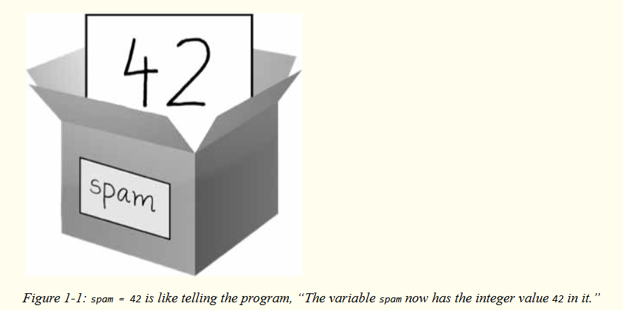
Storing Values in Variables

Slide 20
Storing Values in Variables
For example, enter the following into the interactive shell:
➊ >>> spam = 40
>>> spam
>>> eggs = 2
➋ >>> spam + eggs
>>> spam + eggs + spam
➌ >>> spam = spam + 2
>>> spam
A variable is initialized (or created) the first time a value is stored in it ➊.
After that, you can use it in expressions with other variables and values ➋.
When a variable is assigned a new value ➌, the old value is forgotten, which is why spam evaluated to 42 instead of 40 at the end of the example.
This is called overwriting the variable.

Slide 21
Storing Values in Variables
Enter the following code into the interactive shell to try overwriting a string:
>>> spam = 'Hello’
>>> spam
>>> spam = 'Goodbye’
>>> spam
Just like the box, the spam variable in this example stores 'Hello' until you replace the string with 'Goodbye'.

Slide 22
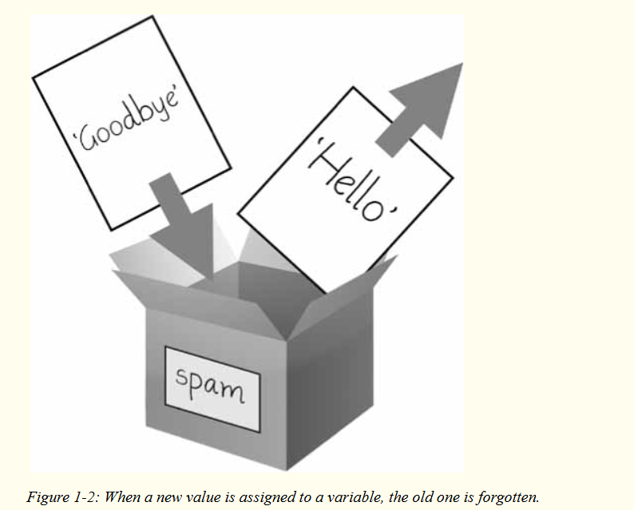
Storing Values in Variables

Slide 23
Storing Values in Variables
Variable Names
A good variable name describes the data it contains.
Imagine that you moved to a new house and labeled all of your moving boxes as Stuff. You’d never find anything!.
But in your programs, a descriptive name will help make your code more readable.
Though you can name your variables almost anything, Python does have some naming restrictions. You can name a variable anything as long as it obeys the following three rules:
It can be only one word with no spaces.
It can use only letters, numbers, and the underscore (_) character.
It can’t begin with a number.

Slide 24
Storing Values in Variables
Table 1-3: Valid and Invalid Variable Names
Valid variable names | Invalid variable names
current_balance | current-balance (hyphens are not allowed)
currentBalance | current balance (spaces are not allowed)
account4 | 4account (can’t begin with a number)
_42 | 42 (can’t begin with a number)
TOTAL_SUM | TOTAL_$UM (special characters like $ are not allowed)
hello | 'hello' (special characters like ' are not allowed)

Slide 25
Storing Values in Variables
Variable names are case-sensitive, meaning that spam, SPAM, Spam, and sPaM are four different variables. Though Spam is a valid variable you can use in a program, it is a Python convention to start your variables with a lowercase letter.

Slide 26
Your First Program
➊#This program says hello and asks for my name.
➋ print('Hello, world!’)
print('What is your name?') # ask for their name
➌ myName = input()
➍ print('It is good to meet you, ' + myName)
➎ print('The length of your name is:')
print(len(myName))
➏ print('What is your age?') # ask for their age
myAge = input()
print('You will be ' + str(int(myAge) + 1) + ' in a year.')
Once you’ve entered your source code, save it so that you won’t have to retype it

Slide 27
Your First Program
You should save your programs every once in a while as you type them.
That way, if the computer crashes or you accidentally exit Mu, you won’t lose the code.
As a shortcut, you can press CTRL-S on Windows and Linux or image-S on macOS to save your file.
When there are no more lines of code to execute, the Python program terminates; that is, it stops running. (You can also say that the Python program exits.)

Slide 28
Dissecting Your Program
Comments
The following line is called a comment.
➊ # This program says hello and asks for my name.
Python ignores comments, and you can use them to write notes or remind yourself what the code is trying to do.
Any text for the rest of the line following a hash mark (#) is part of a comment.
Sometimes, programmers will put a # in front of a line of code to temporarily remove it while testing a program. This is called commenting out code, and it can be useful when you’re trying to figure out why a program isn’t working. You can remove the # later when you are ready to put the line back in.
Python also ignores the blank line after the comment. You can add as many blank lines to your program as you want. This can make your code easier to read, like paragraphs in a book.

Slide 29
Dissecting Your Program
The print() Function
The print() function displays the string value inside its parentheses on the screen.
➋ print('Hello, world!')
print('What is your name?') # ask for their name
The line print('Hello, world!') means “Print out the text in the string 'Hello, world!’.”
When Python executes this line, you say that Python is calling the print() function and the string value is being passed to the function.
A value that is passed to a function call is an argument.
Notice that the quotes are not printed to the screen. They just mark where the string begins and ends; they are not part of the string value.

Slide 30
Dissecting Your Program
The print() Function
NOTE
You can also use this function to put a blank line on the screen; just call print() with nothing in between the parentheses.
When you write a function name, the opening and closing parentheses at the end identify it as the name of a function.

Slide 31
Dissecting Your Program
The input() Function
The input() function waits for the user to type some text on the keyboard and press ENTER.
➌ myName = input()
This function call evaluates to a string equal to the user’s text, and the line of code assigns the myName variable to this string value.
You can think of the input() function call as an expression that evaluates to whatever string the user typed in.
If the user entered 'Al', then the expression would evaluate to myName = 'Al'.
If you call input() and see an error message, like NameError: name 'Al' is not defined, the problem is that you’re running the code with Python 2 instead of Python 3.

Slide 32
Dissecting Your Program
Printing the User’s Name
The following call to print() actually contains the expression 'It is good to meet you, ' + myName between the parentheses.
➍ print('It is good to meet you, ' + myName)
Remember that expressions can always evaluate to a single value.
If 'Al' is the value stored in myName on line ➌, then this expression evaluates to 'It is good to meet you, Al’.
This single string value is then passed to print(), which prints it on the screen.

Slide 33
Dissecting Your Program
The len() Function
You can pass the len() function a string value (or a variable containing a string), and the function evaluates to the integer value of the number of characters in that string.
➎ print('The length of your name is:')
print(len(myName))
Enter the following into the interactive shell to try this:
>>> len('hello’)
>>> len('My very energetic monster just scarfed nachos.’)
>>> len(‘’)
Just like those examples, len(myName) evaluates to an integer.

Slide 34
Dissecting Your Program
The len() Function
It is then passed to print() to be displayed on the screen.
The print() function allows you to pass it either integer values or string values, but notice the error that shows up when you type the following into the interactive shell:
>>> print('I am ' + 29 + ' years old.')
The print() function isn’t causing that error, but rather it’s the expression you tried to pass to print(). You get the same error message if you type the expression into the interactive shell on its own.
>>> 'I am ' + 29 + ' years old.'
Python gives an error because the + operator can only be used to add two integers together or concatenate two strings.
You can’t add an integer to a string, because this is ungrammatical in Python.

Slide 35
Dissecting Your Program
The str(), int(), and float() Functions
If you want to concatenate an integer such as 29 with a string to pass to print(), you’ll need to get the value '29', which is the string form of 29.
The str() function can be passed an integer value and will evaluate to a string value version of the integer, as follows:
>>> str(29)
>>> print('I am ' + str(29) + ' years old.’)
Because str(29) evaluates to '29', the expression 'I am ' + str(29) + ' years old.' evaluates to 'I am ' + '29' + ' years old.', which in turn evaluates to 'I am 29 years old.’.
This is the value that is passed to the print() function.
The str(), int(), and float() functions will evaluate to the string, integer, and floating-point forms of the value you pass, respectively.

Slide 36
Dissecting Your Program
The str(), int(), and float() Functions
>>> str(0)
>>> str(-3.14)
>>> int('42’)
>>> int('-99’)
>>> int(1.25)
>>> int(1.99)
>>> float('3.14’)
>>> float(10)

Slide 37
Dissecting Your Program
The str(), int(), and float() Functions
The previous examples call the str(), int(), and float() functions and pass them values of the other data types to obtain a string, integer, or floating-point form of those values.
The str() function is handy when you have an integer or float that you want to concatenate to a string.
The int() function is also helpful if you have a number as a string value that you want to use in some mathematics.
For example, the input() function always returns a string, even if the user enters a number.
Enter spam = input() into the interactive shell and enter 101 when it waits for your text.

Slide 38
Dissecting Your Program
The str(), int(), and float() Functions
>>> spam = input()
>>> spam
The value stored inside spam isn’t the integer 101 but the string '101’.
If you want to do math using the value in spam, use the int() function to get the integer form of spam and then store this as the new value in spam.
>>> spam = int(spam)
>>> spam
Now you should be able to treat the spam variable as an integer instead of a string.
>>> spam * 10 / 5

Slide 39
Dissecting Your Program
The str(), int(), and float() Functions
Note that if you pass a value to int() that it cannot evaluate as an integer, Python will display an error message.
>>> int('99.99’)
>>> int('twelve’)
The int() function is also useful if you need to round a floating-point number down.
>>> int(7.7)
>>> int(7.7) + 1

Slide 40
Dissecting Your Program
The str(), int(), and float() Functions
You used the int() and str() functions in the last three lines of your program to get a value of the appropriate data type for the code.
➏ print('What is your age?') # ask for their age
myAge = input()
print('You will be ' + str(int(myAge) + 1) + ' in a year.')

Slide 41
Dissecting Your Program
The str(), int(), and float() Functions
TEXT AND NUMBER EQUIVALENCE
Although the string value of a number is considered a completely different value from the integer or floating-point version, an integer can be equal to a floating point.
>>> 42 == '42'
False
>>> 42 == 42.0
True
>>> 42.0 == 0042.000
True
Python makes this distinction because strings are text, while integers and floats are both numbers.

Slide 42
Dissecting Your Program
The str(), int(), and float() Functions
The myAge variable contains the value returned from input().
Because the input() function always returns a string (even if the user typed in a number), you can use the int(myAge) code to return an integer value of the string in myAge.
This integer value is then added to 1 in the expression int(myAge) + 1.
The result of this addition is passed to the str() function: str(int(myAge) + 1).
The string value returned is then concatenated with the strings 'You will be ' and ' in a year.' to evaluate to one large string value.
This large string is finally passed to print() to be displayed on the screen.

Slide 43
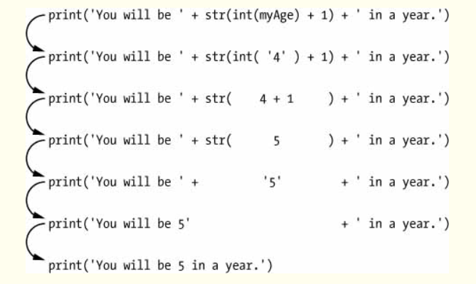
Dissecting Your Program
The str(), int(), and float() Functions
Let’s say the user enters the string '4' for myAge. The string '4' is converted to an integer, so you can add one to it. The result is 5. The str() function converts the result back to a string, so you can concatenate it with the second string, 'in a year.', to create the final message. These evaluation steps would look something like the following:

Slide 44
Practice Questions
1. Which of the following are operators, and which are values?
*
'hello'
-88.8
-
/
+
5
2. Which of the following is a variable, and which is a string?
spam
'spam'
3. Name three data types.
4. What is an expression made up of? What do all expressions do?

Slide 45
Practice Questions
5. This chapter introduced assignment statements, like spam = 10. What is the difference between an expression and a statement?
6. What does the variable bacon contain after the following code runs?
bacon = 20
bacon + 1
7. What should the following two expressions evaluate to?
'spam' + 'spamspam'
'spam' * 3
8. Why is eggs a valid variable name while 100 is invalid?
9. What three functions can be used to get the integer, floating-point number, or string version of a value?
10. Why does this expression cause an error? How can you fix it?
'I have eaten ' + 99 + ' burritos.'

